Slide 1








FINANCIAL RISK ANALYSIS
CREDIT CARD DEFAULT
TAIWAN

Slide 2
THE CREW
ENAVAMSHI GADIKOTA
MOHIT SARDAR
RADHAKRISHNA
ADARSH RAJ
SRUTHI BASANI
NAVEEN KONETI
Mentor

Slide 3
GIST OF DOMAIN
What are Credit Cards?
A credit card are typically issued by banks, and it enables the cardholder to borrow funds from that institution/bank and issuers customarily pre-set borrowing limits, based on an individual's credit rating, they impose the condition that cardholders pay back the borrowed money, plus interest, as well as any additional agreed-upon charges.
What’s in it for banks?
Credit card business is one of the key areas in the banking industry where there exists a huge money flow. Credit card business has been a huge success in the banking market over the years. Most of the banks are also interested in this area expecting a good revenue. Many of the customers use their credit cards beyond their repayment capabilities leading to high debt accumulation and finally defaulting the credits. Classifying the risky and non-risky customers has become a very big challenge for banks.
Problem Statement..!
Identifying the risky and non-risky customers based on the customer characteristics, helping the bank to predict if a customer can repay his credits to the bank in the coming months.

Slide 4
ROAD MAP
EXPLORATORY
DATA ANALYSIS
STATISTICAL ANALYSIS
BASELINE MODEL
1
2
3
2
2
DATA
ENSEMBLES
PERFORMANCE TUNING
5
4
5
4
PREDICTIONS
EVALUATION
6
7
6
7
BUSINESS SOLUTION

Slide 5
DATA DESCRIPTION
LIMIT_BAL : Amount of the credit offered per month
SEX : Customer’s Gender (1 = Male, 2 = Female)
EDUCATION : Level of education of the customer (0 , 1 = Graduate School, 2 = University, 3 = High School, 4 = Others, 5 ,6 )
MARRIAGE : Marital status of the customer (0 , 1 = Married, 2 = Single, 3 = Others)
AGE : Customer’s Age
History of past payment (April 2005 to Sept 2005)
Repay : Repayment Status[-2, -1, 0, 1, 2, 3, 4, 5, 6, 7, 8, 9]
Bill_Amt : Amount of bill statement
Pre_Pay : Amount of previous payment
DEFAULT

Slide 6





SWOT ANALYSIS
STRENGTHS
WEAKNESS
Can Understand the spending patterns of the customers.
No missing values
No data point can be considered as an outlier in the credit card business
Imbalanced data.
Missing information and explanation about the labels.
Due to the limited information there is a good chance the conclusions do not apply to the entire population.
Strengths
Weakness
THREATS
Threats
OPPORTUNITIES
When a good customer classified as a defaulter it can lead to a bad customer experience (basically wrong conclusions)
When a defaulter goes un-identified then it can be a loss to business
Opportunities
Use the data to create more new features and predict whether the customer will default the next month.
Study the spending and payment pattern and make relevant recommendation to the business

Slide 7
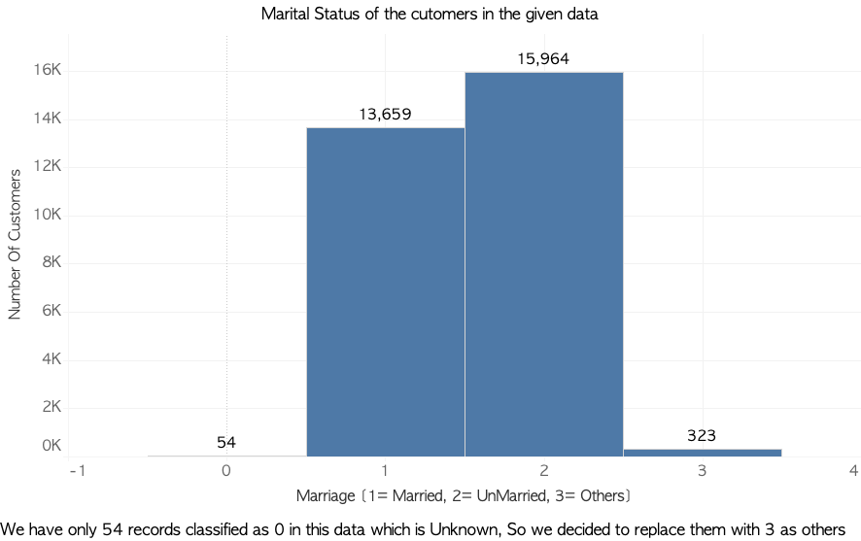
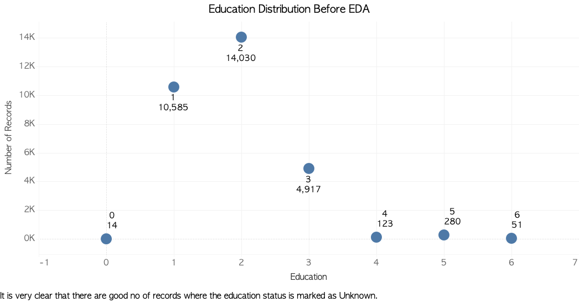
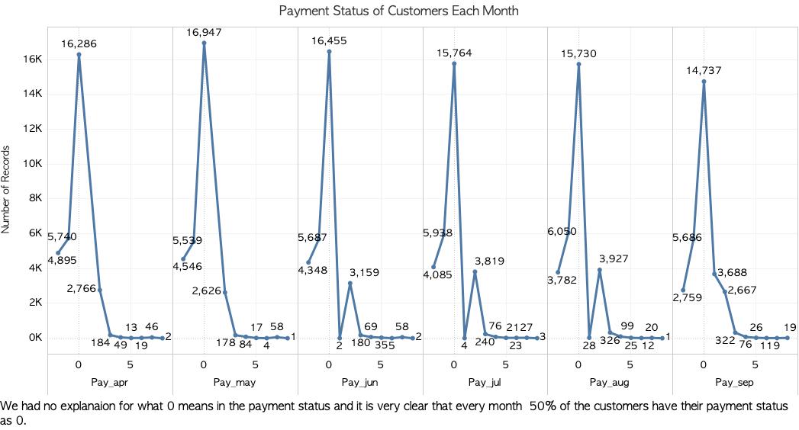
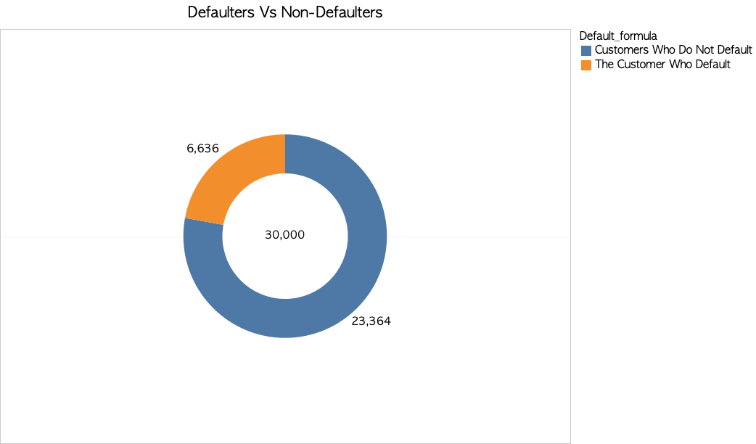
EXPLORATORY DATA ANALYSIS

Slide 8
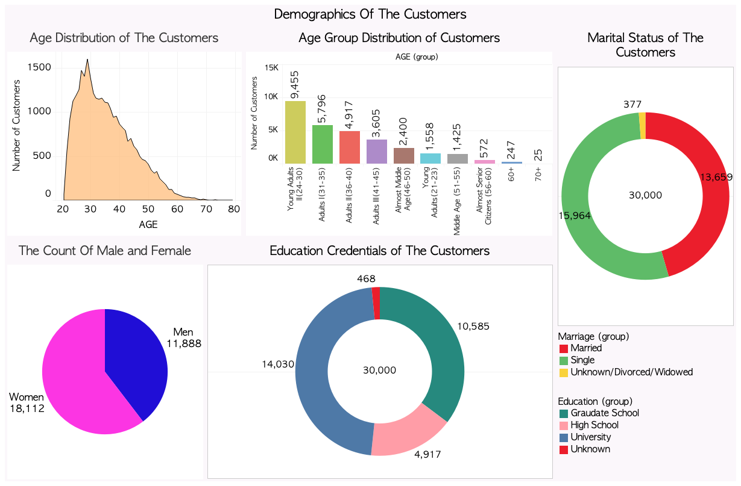

Slide 9
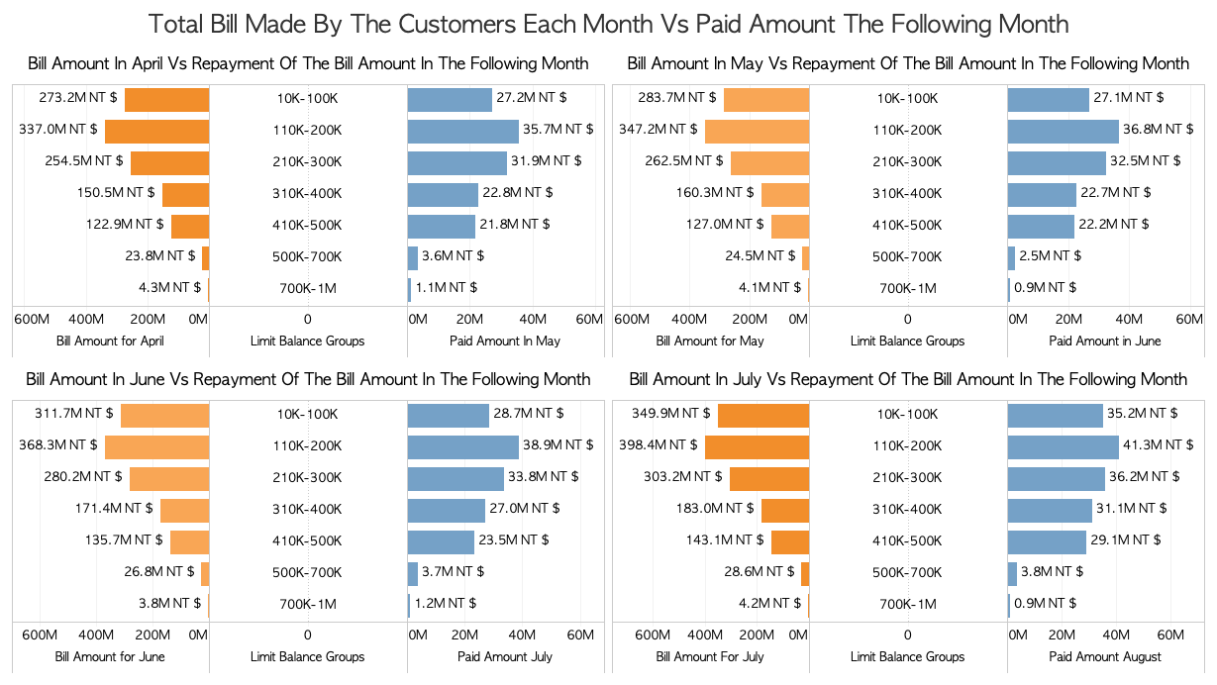

Slide 10
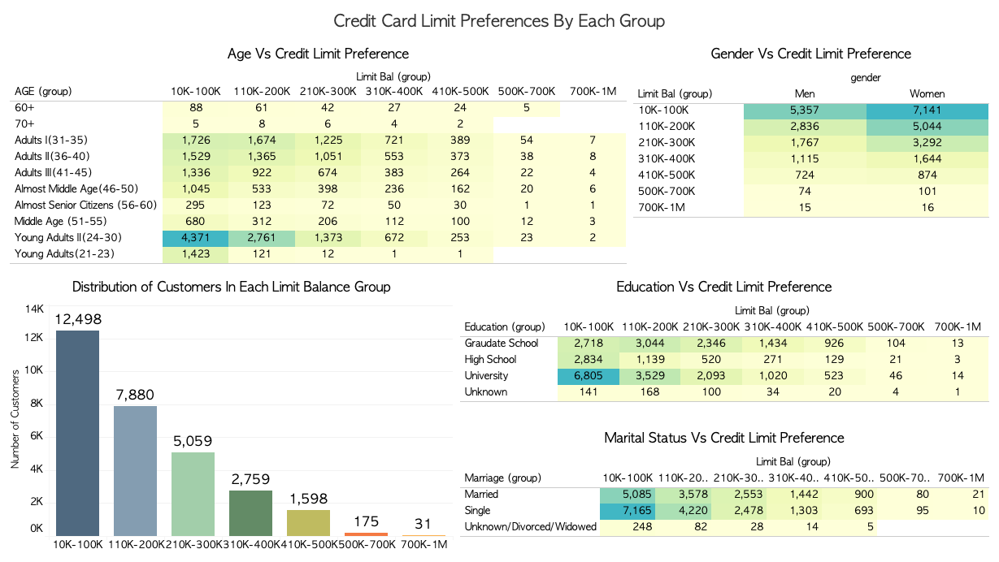

Slide 11
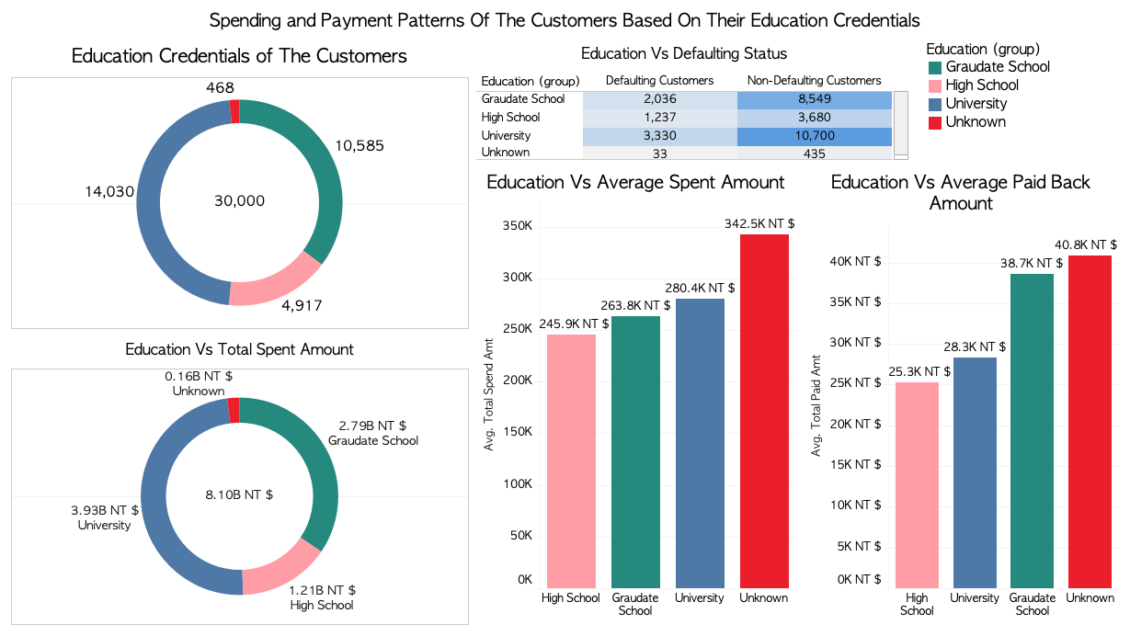

Slide 12
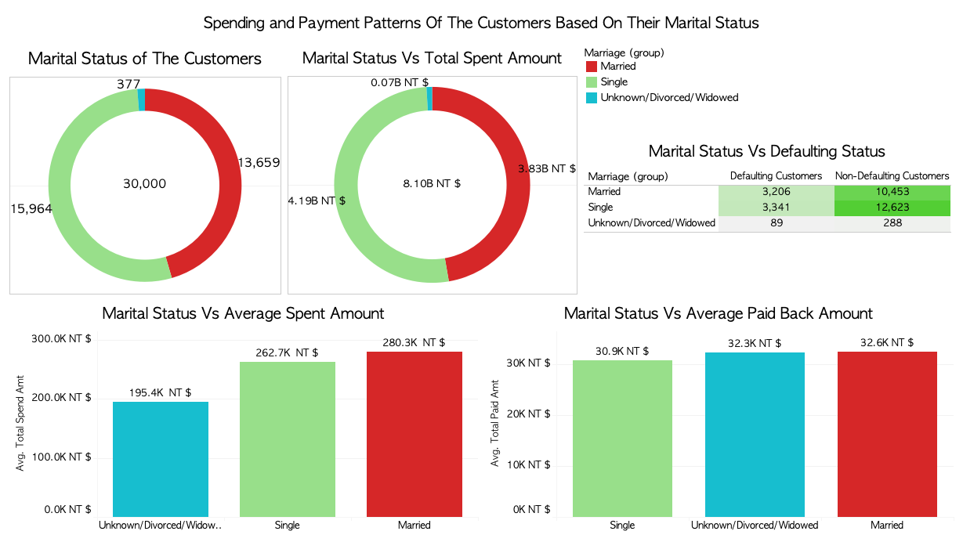

Slide 13
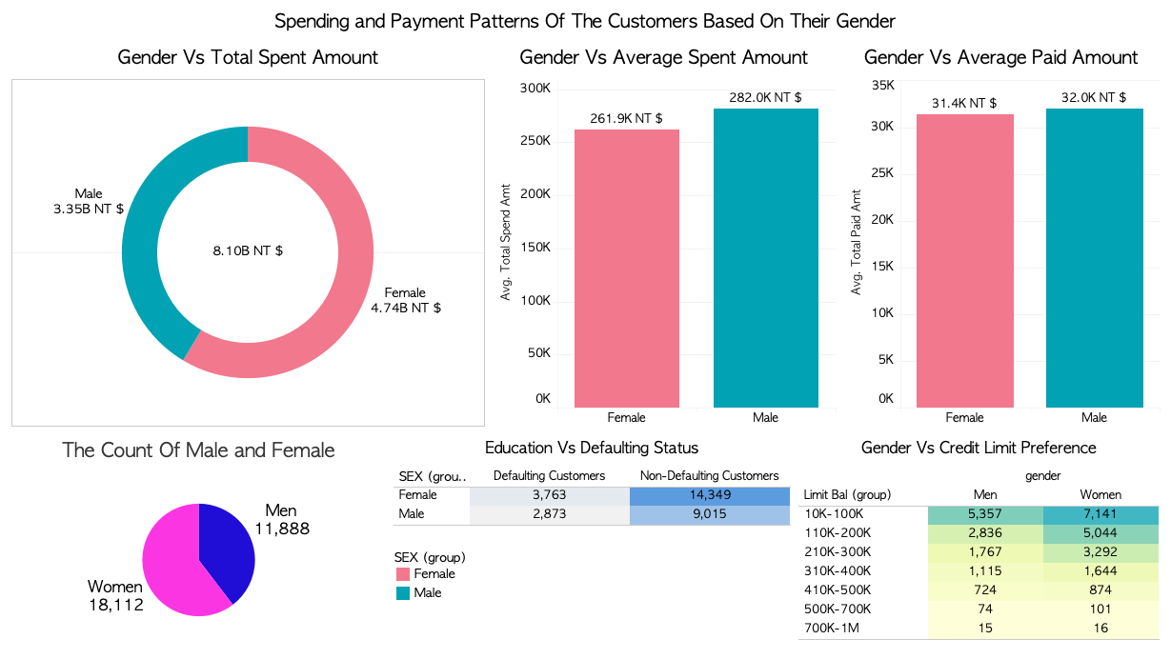

Slide 14
STATISTICAL DATA ANALYSIS
CATEGORICAL
NUMERICAL
Variable | P value | Decision
Sex | 4.94 e⁻¹² | Reject Null Hypothesis
Education | 1.23 e⁻³² | Reject Null Hypothesis
Marriage | 8.82 e⁻⁸ | Reject Null Hypothesis
Variable | P value | Decision
Limit Balance | 6.12e⁻¹⁹⁰ | Reject Null Hypothesis
Age | 0.186 | Accept Null Hypothesis
Bill_Amt Sept | 5.75 e⁻⁶ | Reject Null Hypothesis
Bill_Amt Aug | 0.003 | Reject Null Hypothesis
Bill_Amt July | 0.014 | Reject Null Hypothesis
Bill_Amt June | 0.074 | Accept Null Hypothesis
Bill_Amt May | 0.118 | Accept Null Hypothesis
Bill_Amt April | 0.494 | Accept Null Hypothesis
Pre_pay Sept | 2.31e⁻¹⁷⁰ | Reject Null Hypothesis
Pre_pay Aug | 4.98e⁻¹⁵¹ | Reject Null Hypothesis
Pre_pay July | 4.49e⁻¹²⁹ | Reject Null Hypothesis
Pre_pay June | 3.64e⁻¹⁰⁹ | Reject Null Hypothesis
Pre_pay May | 5.62 e⁻⁹¹ | Reject Null Hypothesis
Pre_pay April | 1.59 e⁻⁹⁸ | Reject Null Hypothesis
Variable | P value | Decision
Repay Sept | 0 | Reject Null Hypothesis
Repay August | 0 | Reject Null Hypothesis
Repay July | 0 | Reject Null Hypothesis
Repay June | 0 | Reject Null Hypothesis
Repay May | 0 | Reject Null Hypothesis
Repay April | 0 | Reject Null Hypothesis

Slide 15
EVALUATION METRICS
Proportion of correctly identified instances
Measure of inter-rater reliability
F1
SCORE
Proportion of predicted positives that were correct
RECALL
ACCURACY
COHEN’S
KAPPA
PRECISION
Harmonic mean of Precision and Recall
Proportion of Actual positives predicted correctly

Slide 16
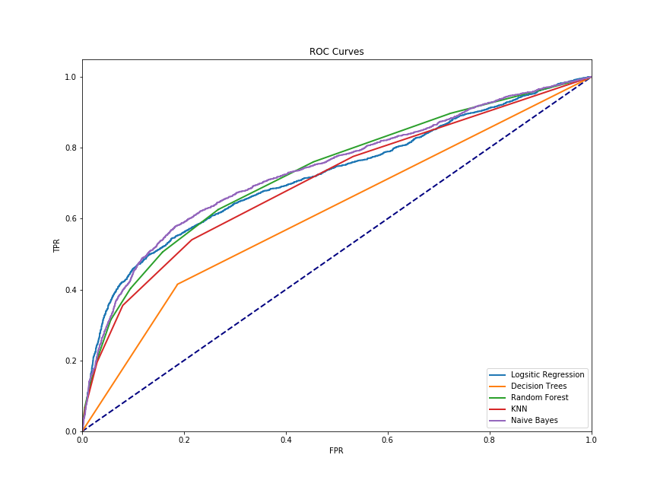
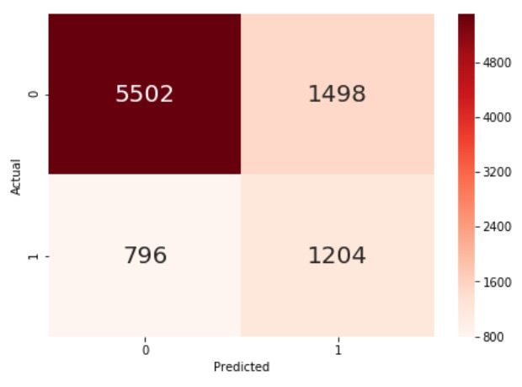
BASELINE MODELS
METRIC| |MODEL | ACCURACY | PRECISION | RECALL | F1SCORE
LOGISTIC REGRESSION | 0.81 | 0.71 | 0.23 | 0.35
KNN | 0.79 | 0.56 | 0.36 | 0.43
NAIVE BAYES | 0.75 | 0.45 | 0.60 | 0.51
DECISION TREES | 0.72 | 0.38 | 0.42 | 0.40
RANDOM FOREST | 0.81 | 0.62 | 0.31 | 0.42

Slide 17
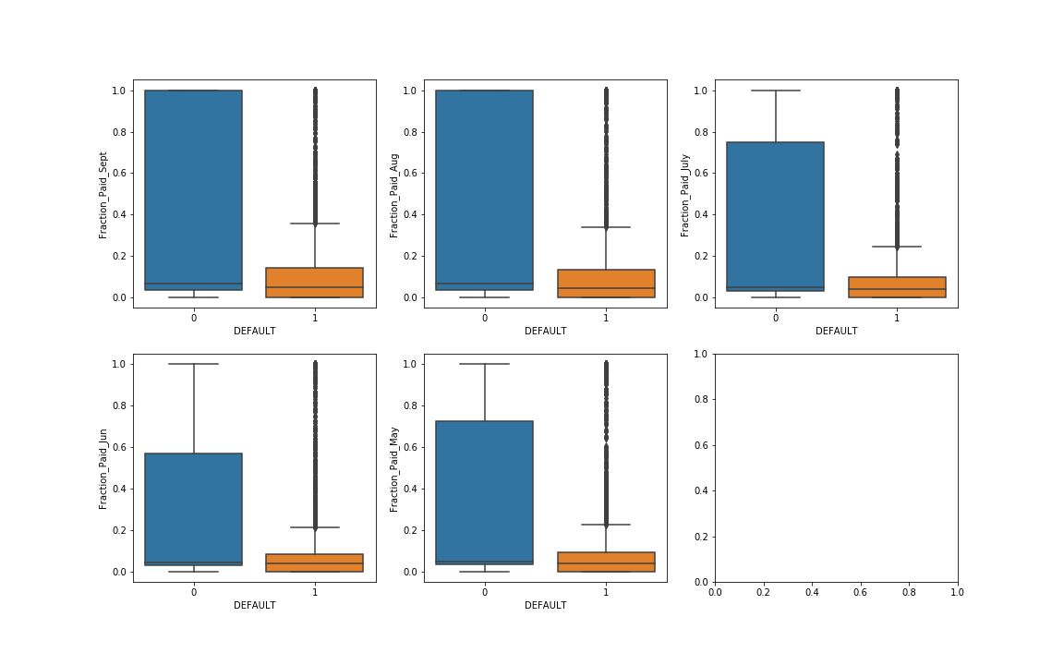
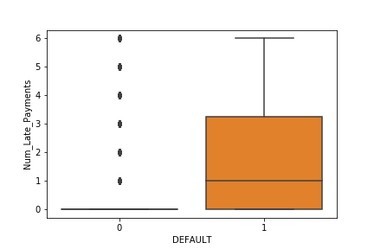
FEATURE ENGINEERING
Repay_Cut (April - Sept)
<=0, >0
Monthly Dues (May - Sept)
How much payment is due from each month
Bill_amt – pre_pay
Fraction of Limit Spent (April - Sept)
Proportion of LIMIT spent each month
Bill_Amt / LIMIT_BAL
Fraction Paid per Month (May - Sept)
Proportion of Bill Paid each month
Pre_Pay / Bill_Amt
Number of Late Payments
Total number of months with late payments
0-6

Slide 18
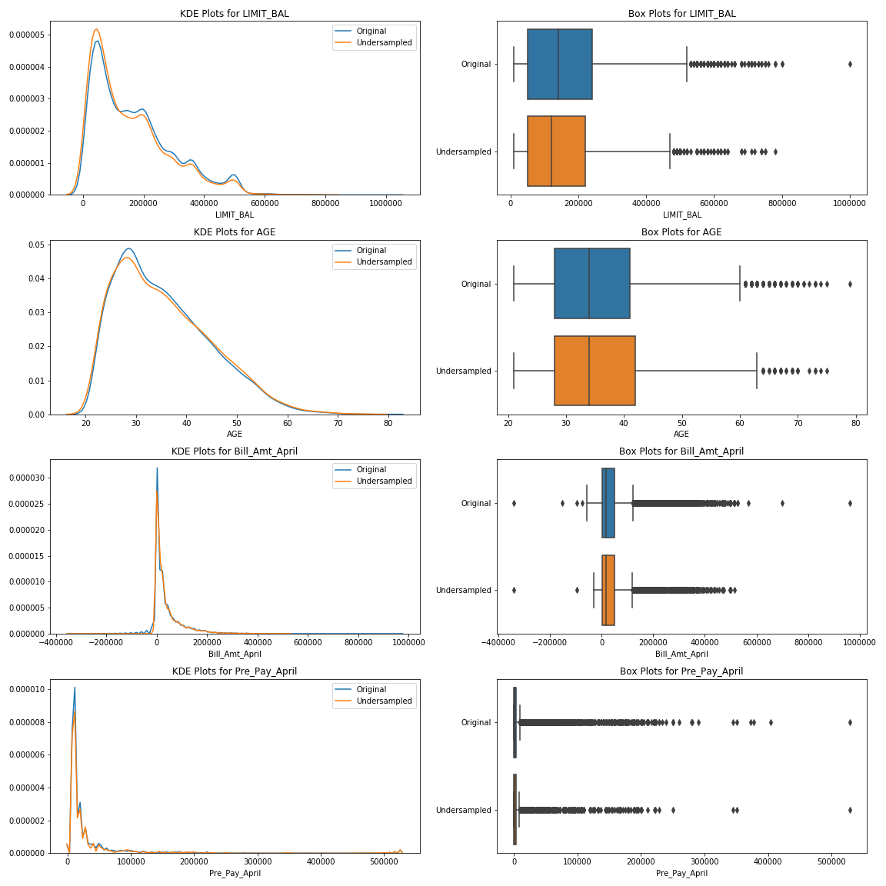
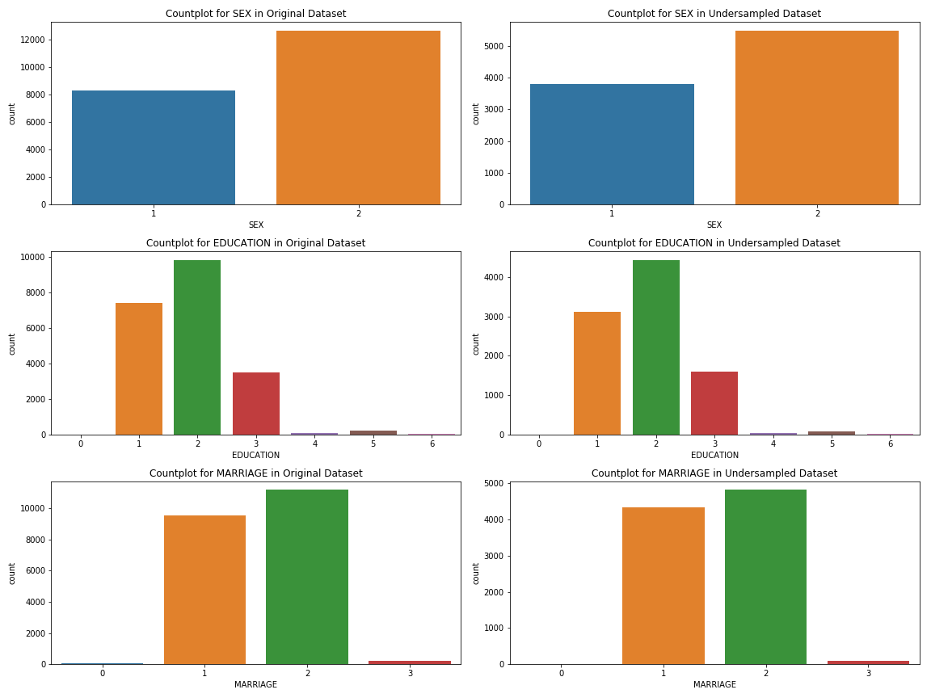
DATA BALANCING UNDER SAMPLING
Comparing Distributions before and after under sampling:

Slide 19
DATA BALANCING UNDER SAMPLING
Recall = 0.665
F1-Score = 0.474
Recall = 0.633
F1-Score = 0.426
Random Forest
Logistic Regression
Naive Bayes
KNN
Decision Trees
Recall = 0.58
F1-Score = 0.523
Recall = 0.588
F1-Score = 0.506
Recall = 0.603
F1-Score = 0.494

Slide 20
DATA BALANCING OVER SAMPLING
Border Line
SMOTE
Recall = 0.731
F1-Score = 0.468
Recall = 0.556
F1-Score = 0.525
Logistic Regression
Naive Bayes
XGB Classifier
KNN
Gradient Boosting
Recall = 0.006
F1-Score = 0.013
Recall = 0.843
F1-Score = 0.389
Recall = 0.556
F1-Score = 0.525

Slide 21
ENSEMBLE METHODS
1
Random Forest
2
Extra Trees Classifier
3
XG Boosting
Recall = 0.618
F1-Score = 0.537
Recall = 0.556
F1-Score = 0.525
Recall = 0.556
F1-Score = 0.525
4
Voting Classifier
5
Gradient Boosting(default)
6
Gradient Boosting(Random Forest)
Recall = 0.753
F1-Score = 0.47
Recall = 0.556
F1-Score = 0.525
Recall = 0.487
F1-Score = 0.506

Slide 22
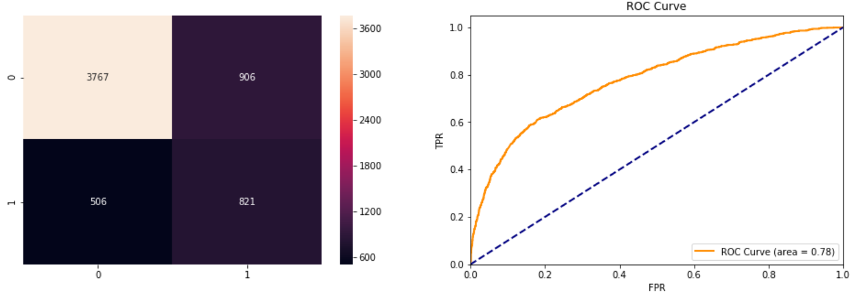
BEST MODEL
Random Forests (Best parameters)
criterion : Gini
max_depth : 5
max_features : log2
min_samples_leaf : 1
min_samples_split : 2
Accuracy = 0.764
Precision = 0.475
Recall = 0.618
F1 Score = 0.537
Cohen Kappa = 0.383

Slide 23
BUSINESS SOLUTIONS
Important Features:
Num_Late_Payments
Repay_Sept
Repay_Aug
Repay_July
Repay_Jun
Pre_Pay_Sum
Repay_May
Repay_April
With higher the educational qualifications, lower the default rate
Overall Single people spend the most, but on an average married people spend more
Married people more likely to default
On an average, males spend more and have higher default rate

Slide 24

LET’S CLARIFY
THANK YOU

